Slide 1
Scoil Mhuire na nGrást, Belgooly
Safe Routes to School Parent Survey Analysis
Prepared by: Ellen Murphy
Date: December 2021

Slide 2
Scoil Mhuire na nGrást – Parent Survey responses
The school distributed the survey to all parents, via their usual communications methods, during October 2021. Reminders were also issued.
As part of the survey, parents were asked to indicate on a map where their school journey begins, as well as the modes by which students usually travel to school.
Responses received: 202
Students represented: 333
85.6% of school population (based on a total of 389*)
* Based on EOI / Enrolment for 2021-2022

Slide 3
Scoil Mhuire na nGrást – Parent Survey responses
Number of students attending the school per family (shown as percentages)
Q1. How many of your children attend this school?

Slide 4
Scoil Mhuire na nGrást – Parent Survey responses
Gender split of students represented in the survey
Q3. For each child, choose their gender

Slide 5
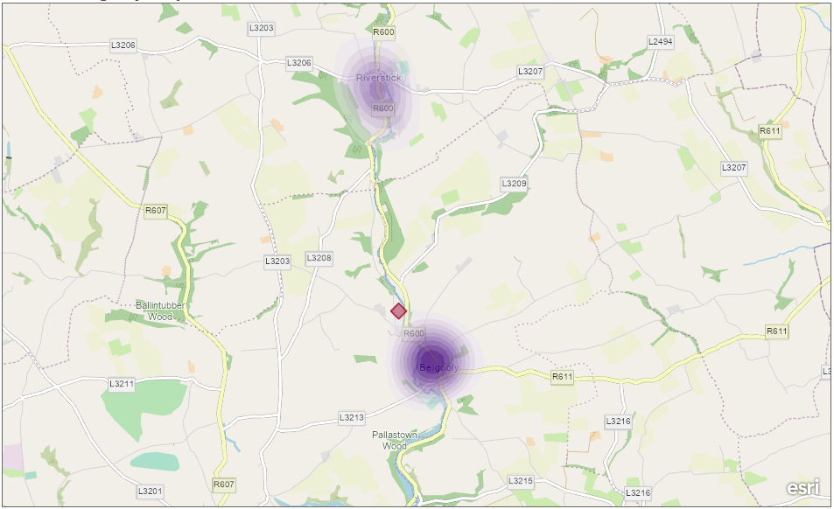
Scoil Mhuire na nGrást: Where students are travelling from
Higher density of students travelling from this area
Lower density of students travelling from this area
Scale:
School location

Slide 6
Scoil Mhuire na nGrást – Parent Survey responses
Number of represented students by class/year (shown as percentages)
Q4. For each child, choose their class/year

Slide 7
Scoil Mhuire na nGrást – Parent Survey responses
How students usually travel to school (shown as percentages)
Q5. For each child, choose how they usually travel to school.
Park and Stride is where a student is driven some of the way to school and walks [at least 5 minutes] the rest of the way.

Slide 8
Scoil Mhuire na nGrást: How students living withing a 2km radius travel to school
How students, within a 2km radius, usually travel to school (shown as percentages)
A total of 132 students start their journey within the 2km radius, representing 39.6% of the students surveyed.

Slide 9
Scoil Mhuire na nGrást – Parent Survey responses
Do you think road safety is a problem around your school?
Q6. Do you think road safety is a problem around your school?

Slide 10
Scoil Mhuire na nGrást – Parent Survey responses
Would you support works at the front of school that improve student safety, putting pedestrians and cyclists first?
Q7. Would you support works at the front of school that improve student safety, putting pedestrians and cyclists first?

Slide 11
Scoil Mhuire na nGrást – Parent Survey responses
Would you support works that improve the walking and cycling routes to your school?
Q8. Would you support works that improve the walking and cycling routes to your school?

Slide 12
Scoil Mhuire na nGrást – Parent Survey responses
What improvements would support you to walk, cycle or scoot to school? (shown as percentages)
Q9. What improvements would support you to walk, cycle or scoot to school?

Slide 13
Scoil Mhuire na nGrást – Parent Comment Categories
Parent Comment Categories

Slide 14
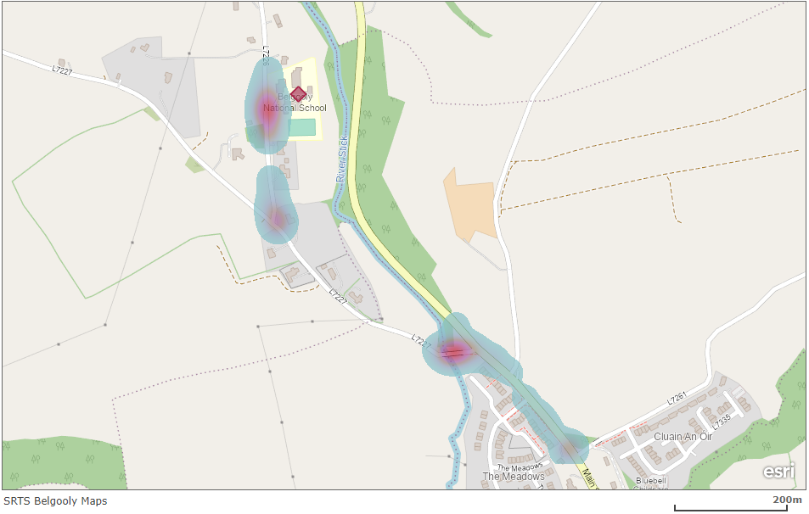
Parent response issue cluster points

Slide 15
End of Document

