Slide 1
Literacy Lift Off
Scoil Mhuire na nGrást
1st Class 2020

Slide 2
What is Literacy Lift Off?
Its origins are from the Reading Recovery programme.
Six week intervention
One hour sessions on every day except Fridays
LLO involves the children being grouped into six groups which will rotate around five stations during the hour.
There will be a reading station, writing station, word work station, re-reading station and an activity station.
Three teachers and an SNA will be running these stations
The needs of each group will be identified and worked on at these stations.

Slide 3
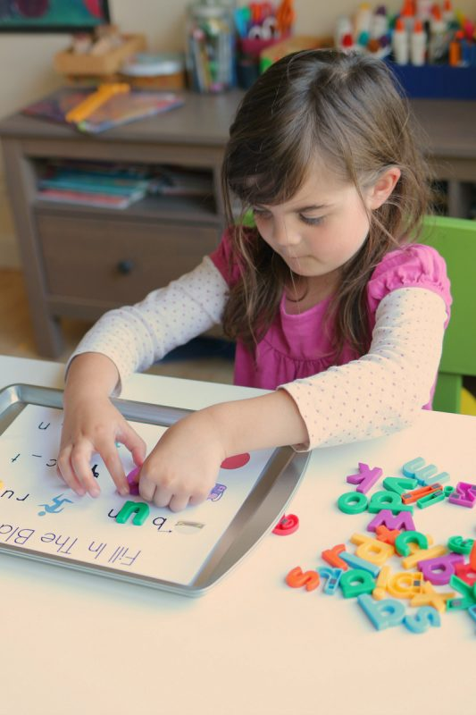
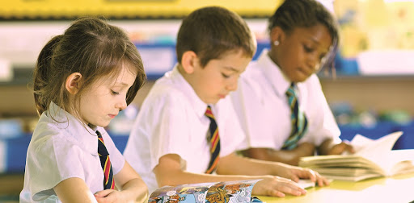
Station Work

Slide 4
What are the strengths of the programme?
The children will be working at their own level.
They get one-to-one tuition time.
The books used are so well graded that the children progress seamlessly through the levels.
The children love it!

Slide 5
The power of re-reading!
Research has shown that re-reading is the key to developing reading fluency.
Fluency in turn is integral to a child’s comprehension.
This is where you come in….!

Slide 6
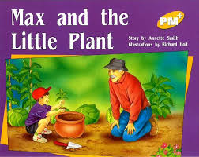
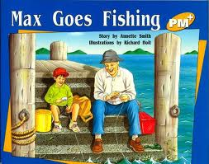
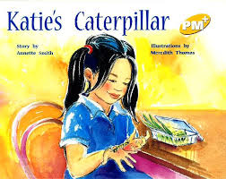
Literacy Lift Off at home
Your child will bring home a book each evening.
If you can sit with your child each evening and read the book with him/her you are giving your child a gift for life.
If you chat about the pictures or story your are developing comprehension and language skills.

Slide 7
What the children say
“I love Literacy Lift Off”
“My favourite part was the writing”
“I loved getting a new book to read”
“I really liked making new words”
“I loved Literacy Lift Off because the time went really fast”
(Senior Infants on the last day of Literacy Lift Off )

Slide 8
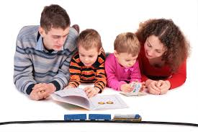
And most importantly
It is a very special time for you. Embrace it and build memories.

